Slide 1
Space Farming
by:Matthew Bigio

Slide 2
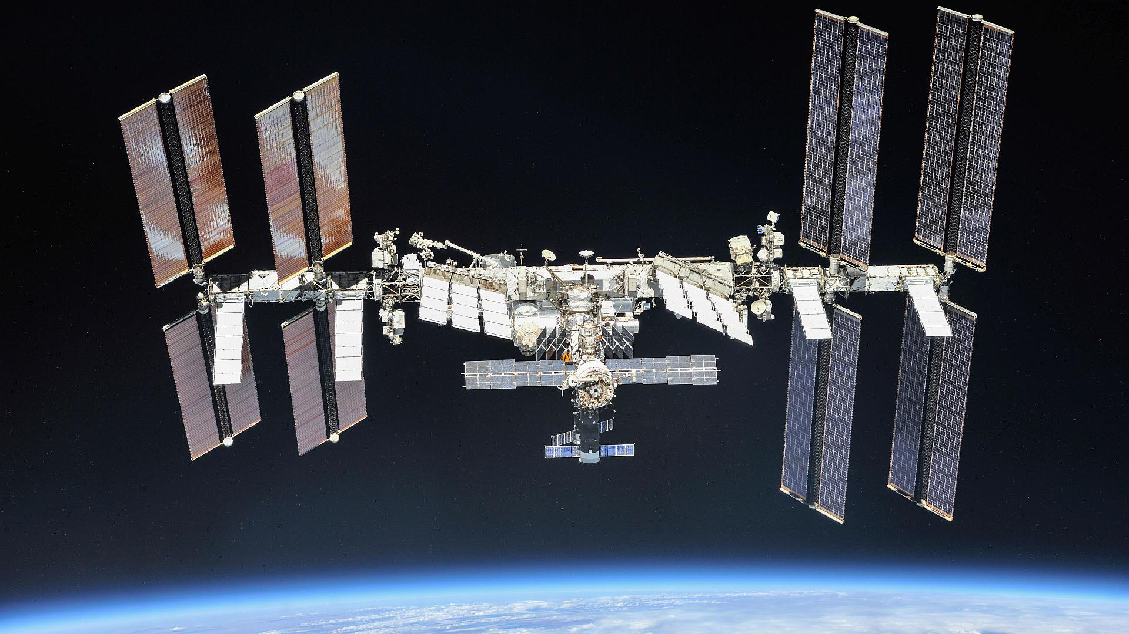
The issue
Refueling in space is difficult
On average $10,000 per kg to the I.S.S
Impractical for future missions
40 days to send rocket up to the I.S.S

Slide 3
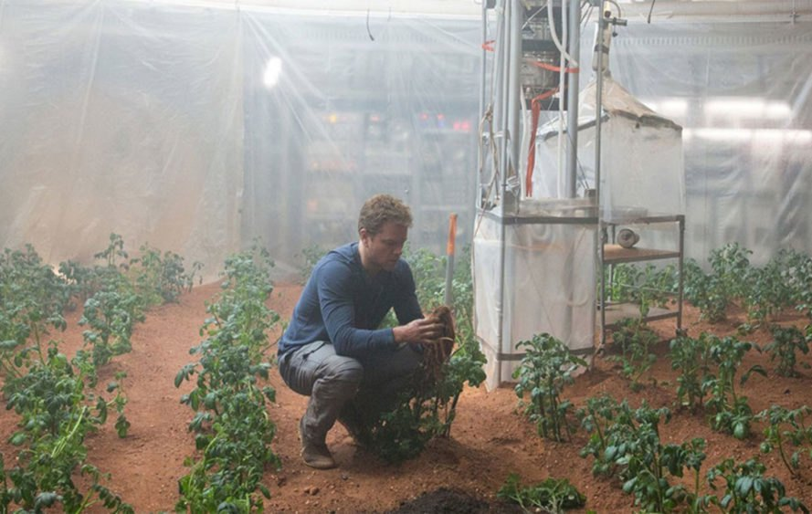
The solution
Space farming

Slide 4
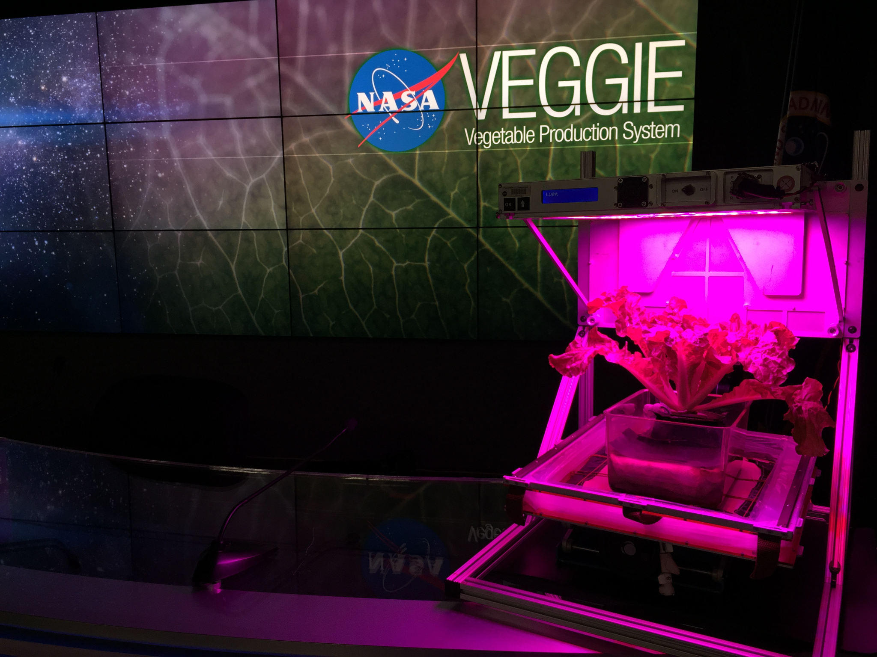
Veggie:The Vegetable Production System
System
70 watts pink LED lights
Wick hydration system
Seed placed in a dirt pillow glued to the tray
A fan to control air and temperature

Slide 5
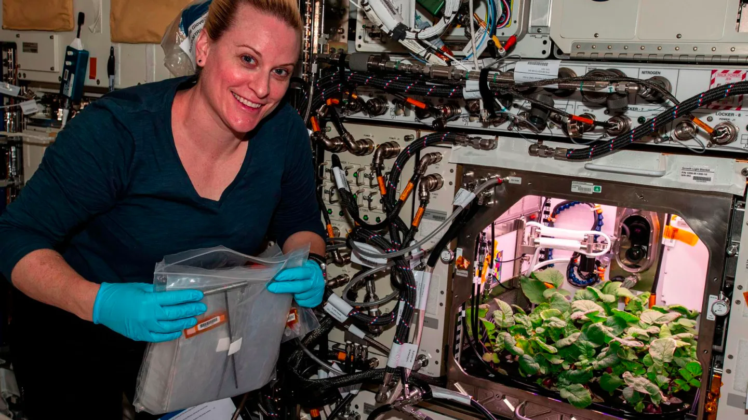
Results
Successfully grown over 15 types of vegetables
Romaine lettuce
Zinnia flowers
Kale
Mizuna Mustard

Slide 6
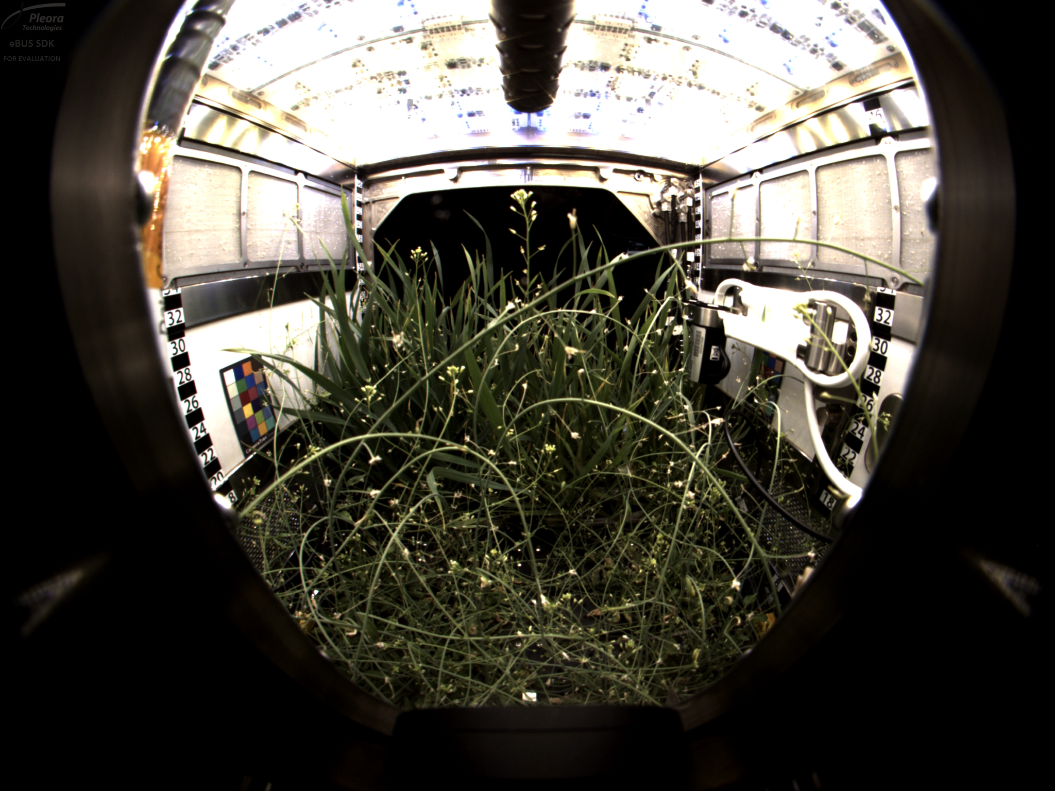
APH:Advance Plant Habitat
A more advanced system:
180 censors
Enclosed area
Automated monitoring from Houston

Slide 7
Benefits for Astronauts
Health:
Dr. Ray Wheeler, lead for Advanced Life Support was quoted saying”"There is evidence that supports fresh foods, such as tomatoes, blueberries and red lettuce are a good source of antioxidants. Having fresh food like these available in space could have a positive impact on people's moods and also could provide some protection against radiation in space,"
It's also been shown that gardening helps improve mental health such as in this 2014 study covery University Schmutz, U., Lennartsson Turner, M., Williams, S., Devereaux, M., & Davies, G. (2014). The benefits of gardening and food growing for health and wellbeing. Garden Organic and Sustain.
No abnormalities have been shown in plants grown in microgravity.

Slide 8
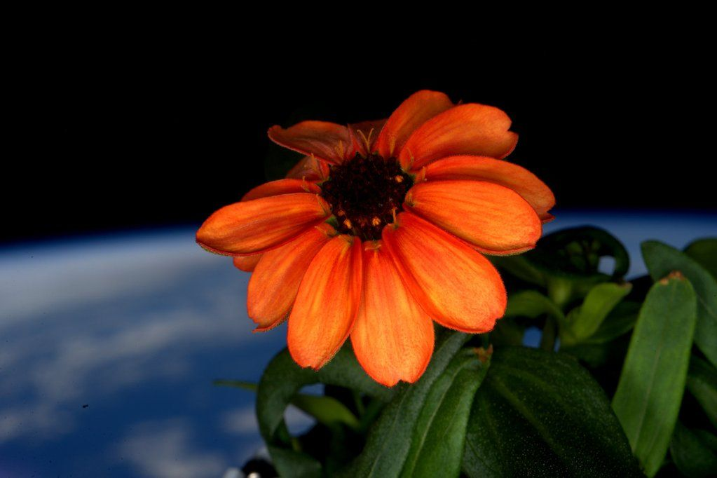
The end:

Slide 9
Sources
Growing Plants in Space | NASA
Space farming - Wikipedia
NASA has early plans to send astronauts to Mars for 30 days | Space
Veggie Fact Sheet (nasa.gov)
What is a Wick System? - Definition from Maximum Yield
The positive effects of gardening on mental health - AgriLife Today (tamu.edu)
launch - If the ISS had an emergency, how long would it take to get a rocket to it? - Space Exploration Stack Exchange
Crew Members Sample Leafy Greens Grown on Space Station | NASA

